Slide 1
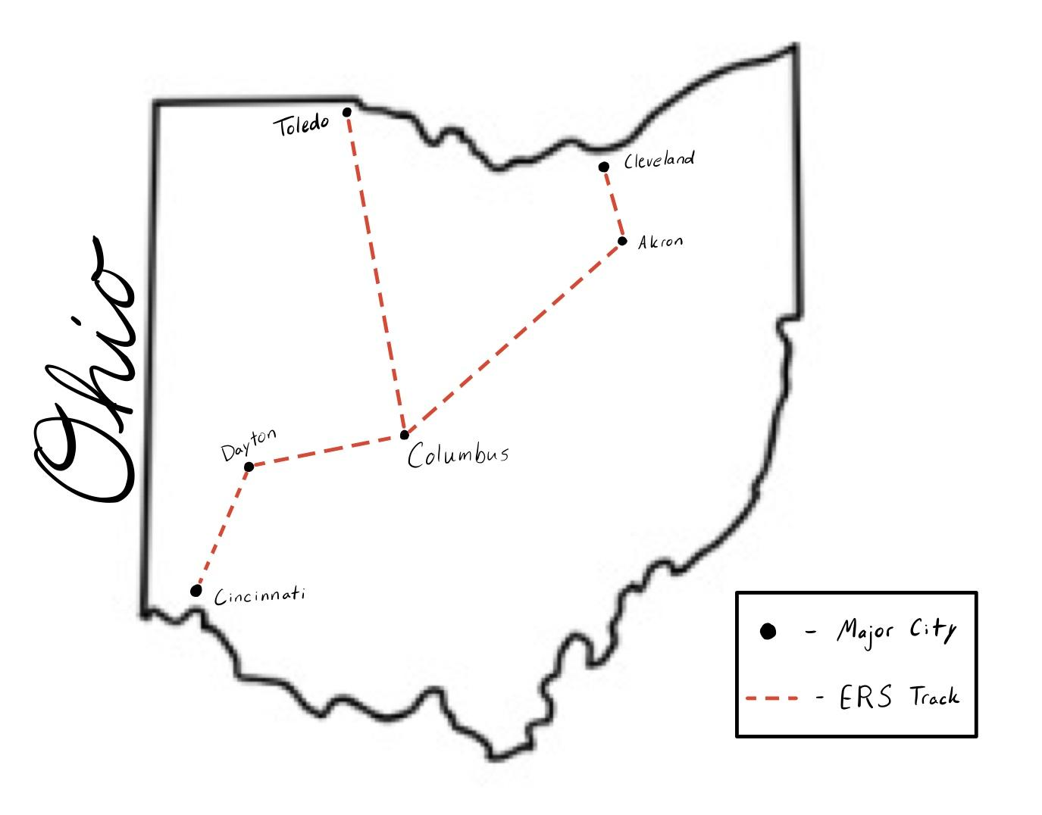
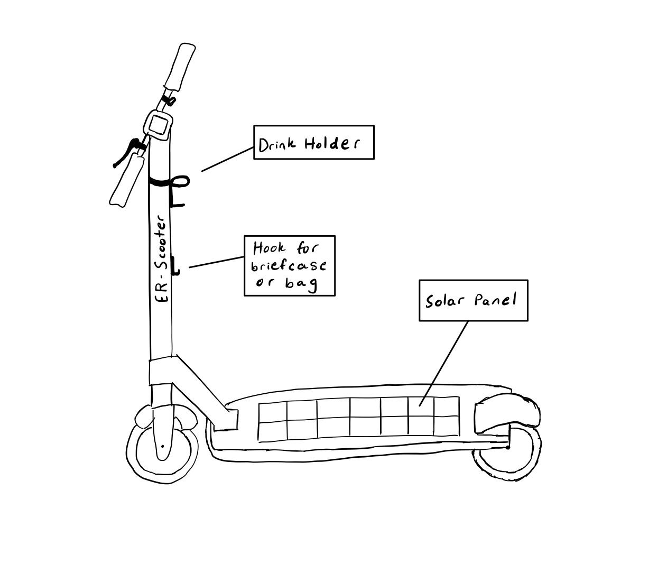
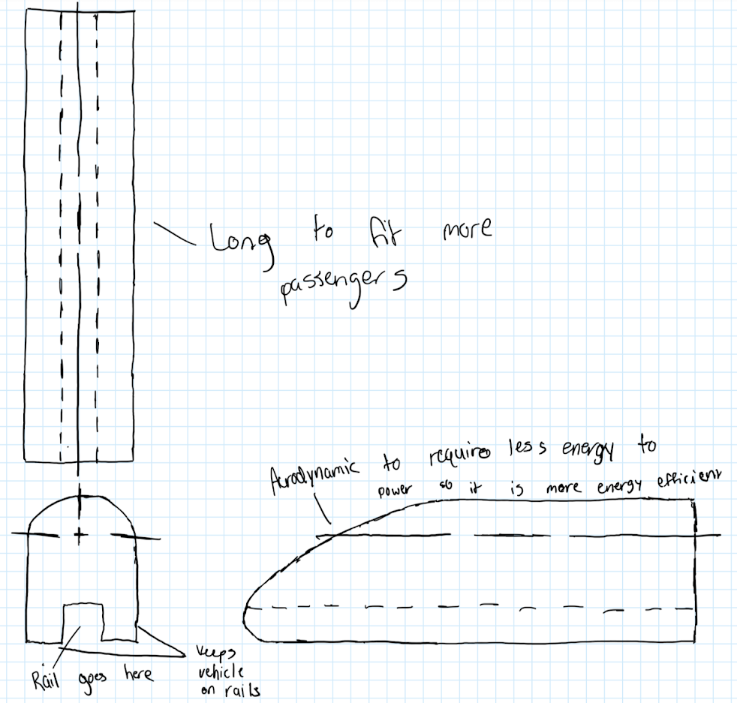
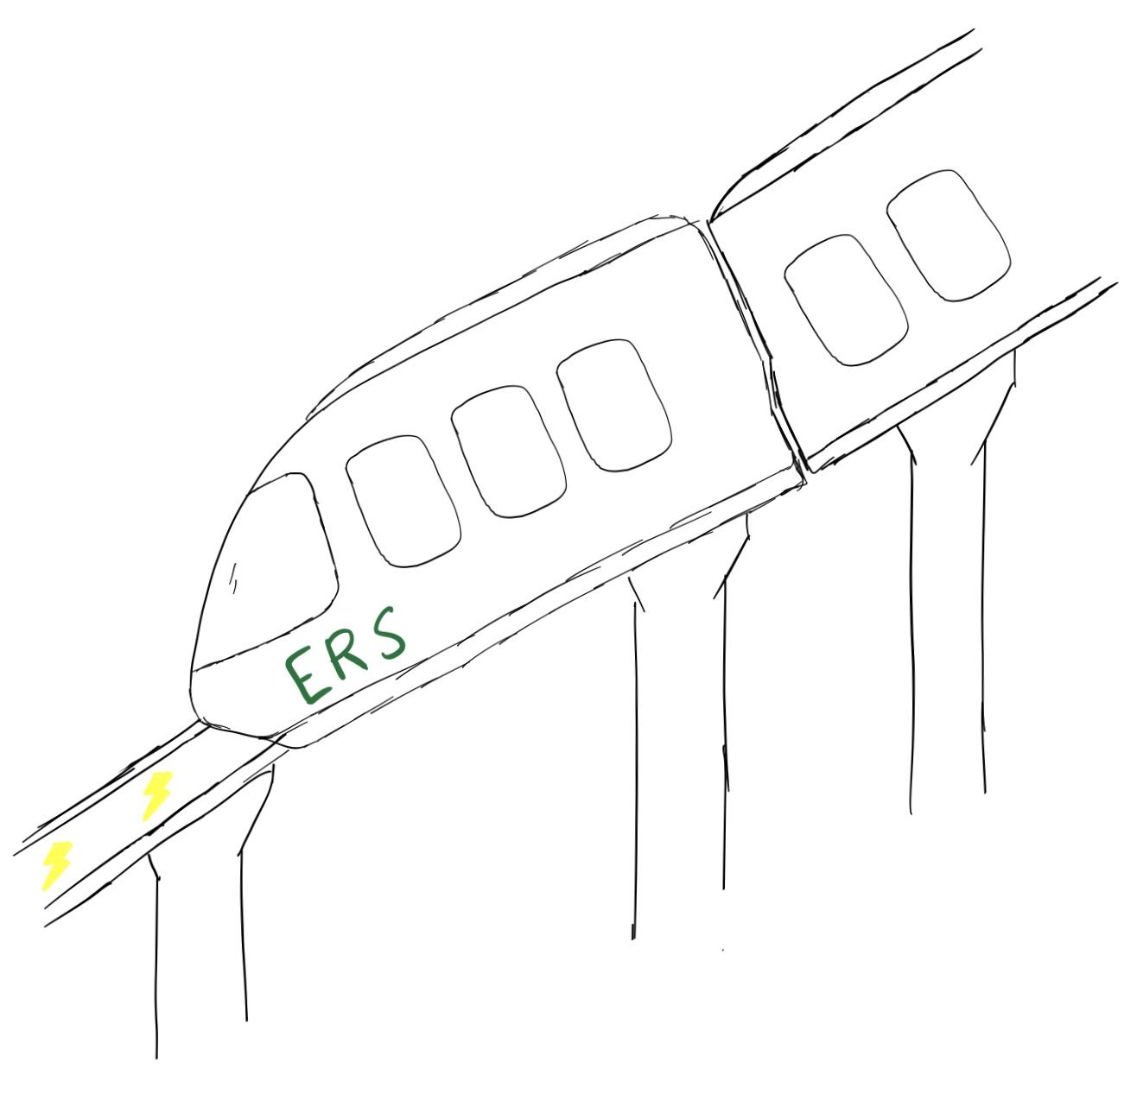
Eco-Rail System (ERS)
Section Number: 9621 Team Letter: O Team Member Names: Hongda Lin, Caleb Bucci, Andrew Nguyen, Jason Turschak
End Users
Product/Prototype Description
1.Wants a reliable and easy way to get to work everyday and save time
2.Wants to be more environmentally friendly
3.Wants to spend more time on his work or hobbies than driving
In our updated pugh scoring matrix, we have found that users care more about things like reliability, safety, and stressfulness of their varying forms of commuting over things like cost, environmental-friendliness, and extra time for hobbies. They also wanted to be more comfortable, because when they are not comfortable they get more stressed, which is the opposite of what they want. They still strongly care about being less stressed and having a faster commute, and they would feel better if the mode of transportation was environmentally friendly, but most said that it wouldn’t affect their decision when using it. Also, after gathering more end-user feedback, we were able to make small changes to our design that helped alleviate any concerns. For instance, the sketch of the scooter design that will be incorporated into our transportation system was updated. It now includes amenities such as a drink holder and a baggage hook for those who thought having their hands full would not allow them to ride the scooters.
Potential Value
Competitive Advantage
Many people, such as those who live far from home or those who live in a heavily trafficked area, often share their concerns about commuting to and from work over long distances every day, especially when it comes to car pollution, time consumption and high-stress levels. We are going to create a product to help these people plan their long-distance commuting every day. We will help them stay away from pollution, we will shorten their commute, and we will lower their stress levels. They shouldn’t need to feel stressed when commuting to and from work every day. They will have a more effective and relaxed way of traveling instead. Therefore, we plan to create an electric-powered monorail, which is environmentally friendly, very quiet, travels fast, has a comfortable interior, and is able to take you anywhere which will help our target audience fulfill their needs of a replacement to driving every day. In addition to creating a monorail system, we will also create an electric scooter hub at every stop, so that even if your destination is a little farther from the designated monorail station you can still save time by hopping onto a scooter which will solve our audience’s problems, including the ones that they may not have even thought of such as having a lower chance of vehicle accidents because the monorail is much safer than driving a car.
ERS: Using the ERS, team O is attempting to reduce the stress induced by normal commuting through conventional means such as cars, bikes, and subway systems. Moreover, the ERS aims to lower the carbon footprint of the average commuter through electric power while making the daily commute safer for everyone, and more efficient. The ERS is able to bypass the traffic that collects on highways leading into metropolitan areas.
Scooter: Along with the ERS, team O plans to implement electric scooters positioned at ERS stops to augment the distance that commuters can travel while on the ERS network of vehicles. These scooters will be solar powered in order to reduce emissions, while also possessing a speed of up to 20 mph in order to facilitate faster travels from the stops than ambulating. The smaller frame of the scooter also allows for easier maneuverability through inner city traffic.
ACKNOWLEDGEMENTS
You can use this space to thank your instructor, GTA, and UTAs! You should also thank anyone else who has helped you during your project.

